Slide 1
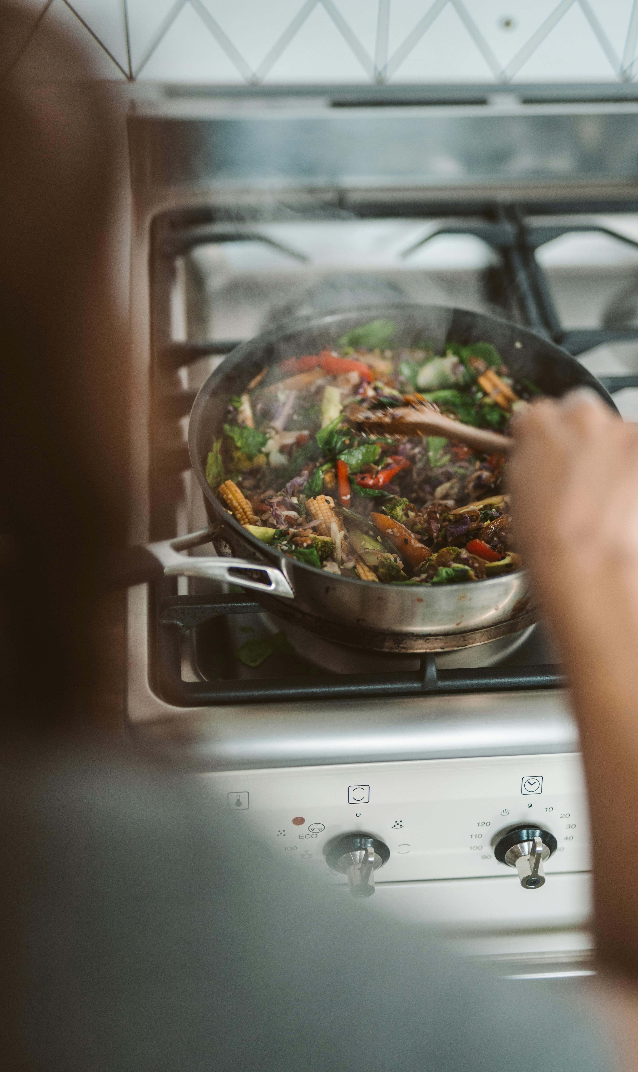
Recipe Site High Traffic Prediction
MD Zehan Alam

Slide 2
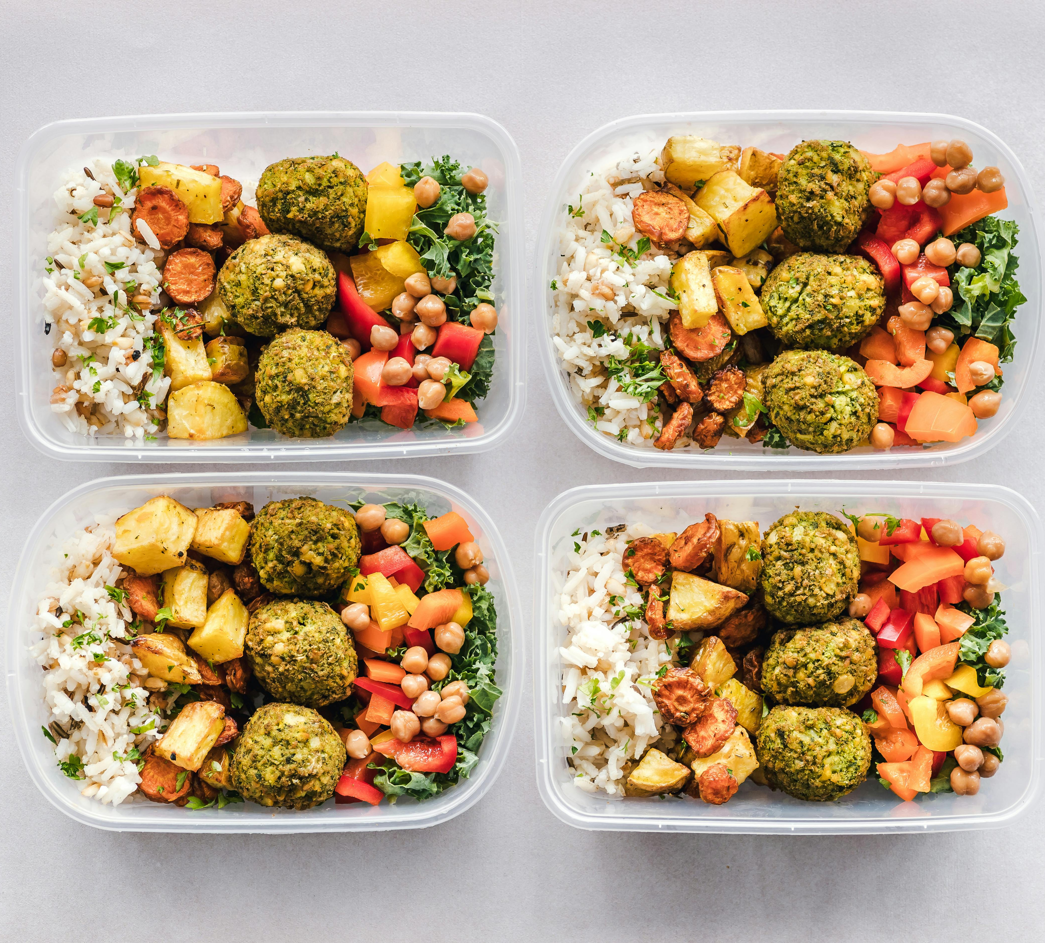
About Tasty Bytes Website’s High Traffic Impact
Currently, recipes are chosen based on personal preference and featured on our website’s homepage.
Featuring popular recipes has resulted in a notable increase in website traffic, with up to a 40% boost observed.
Increased traffic leads to more subscriptions, which directly boosts company revenue.

Slide 3
Goals
Develop a predictive model to identify which recipes are likely to drive high traffic to the website.
Ensure that the predictive model can correctly identify high traffic recipes with at least 80% accuracy.
Use exploratory data analysis (EDA) to understand patterns and trends in the data

Slide 4
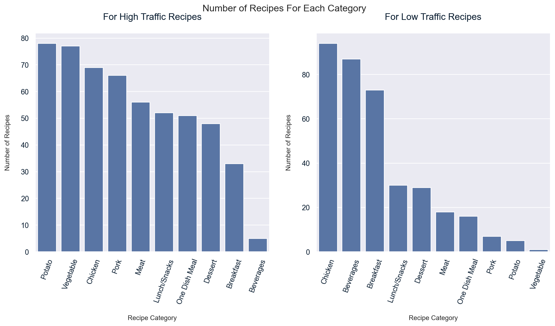
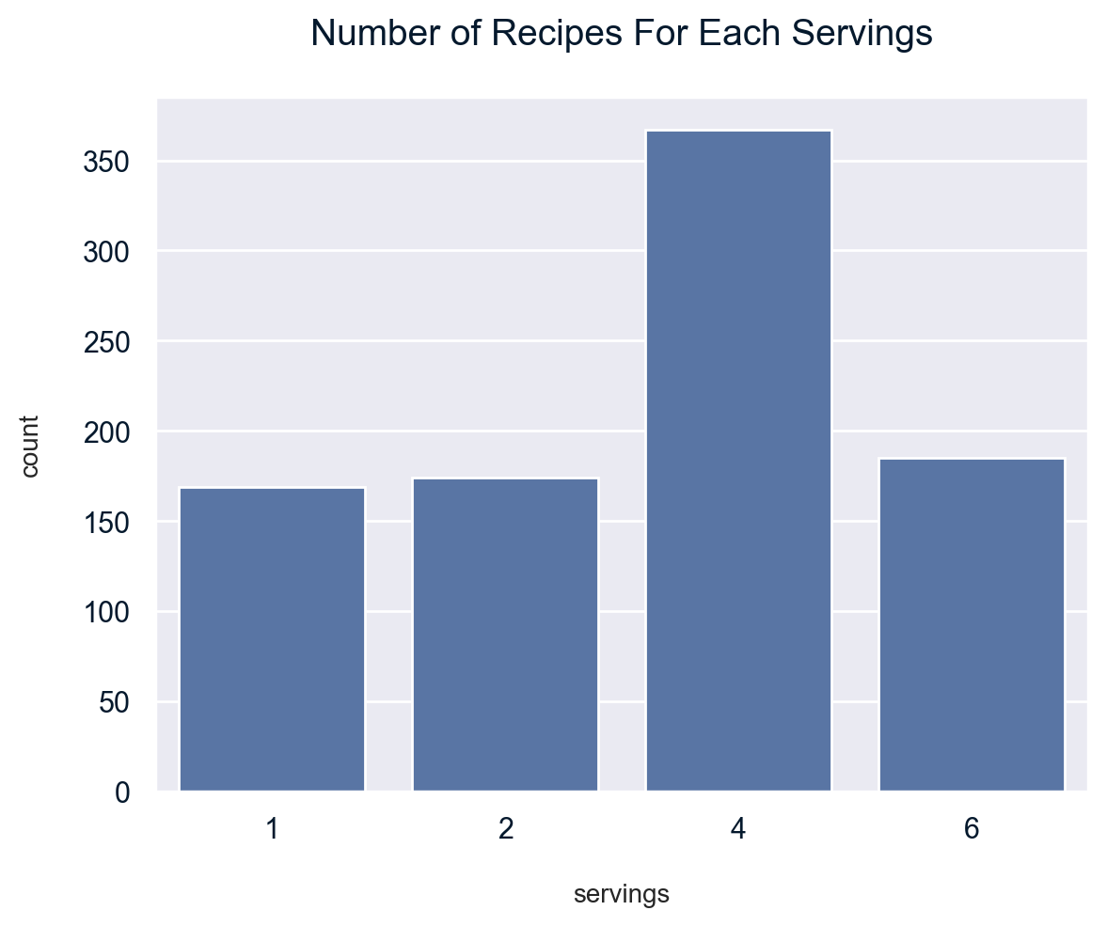
Exploratory Data Analysis

Slide 5
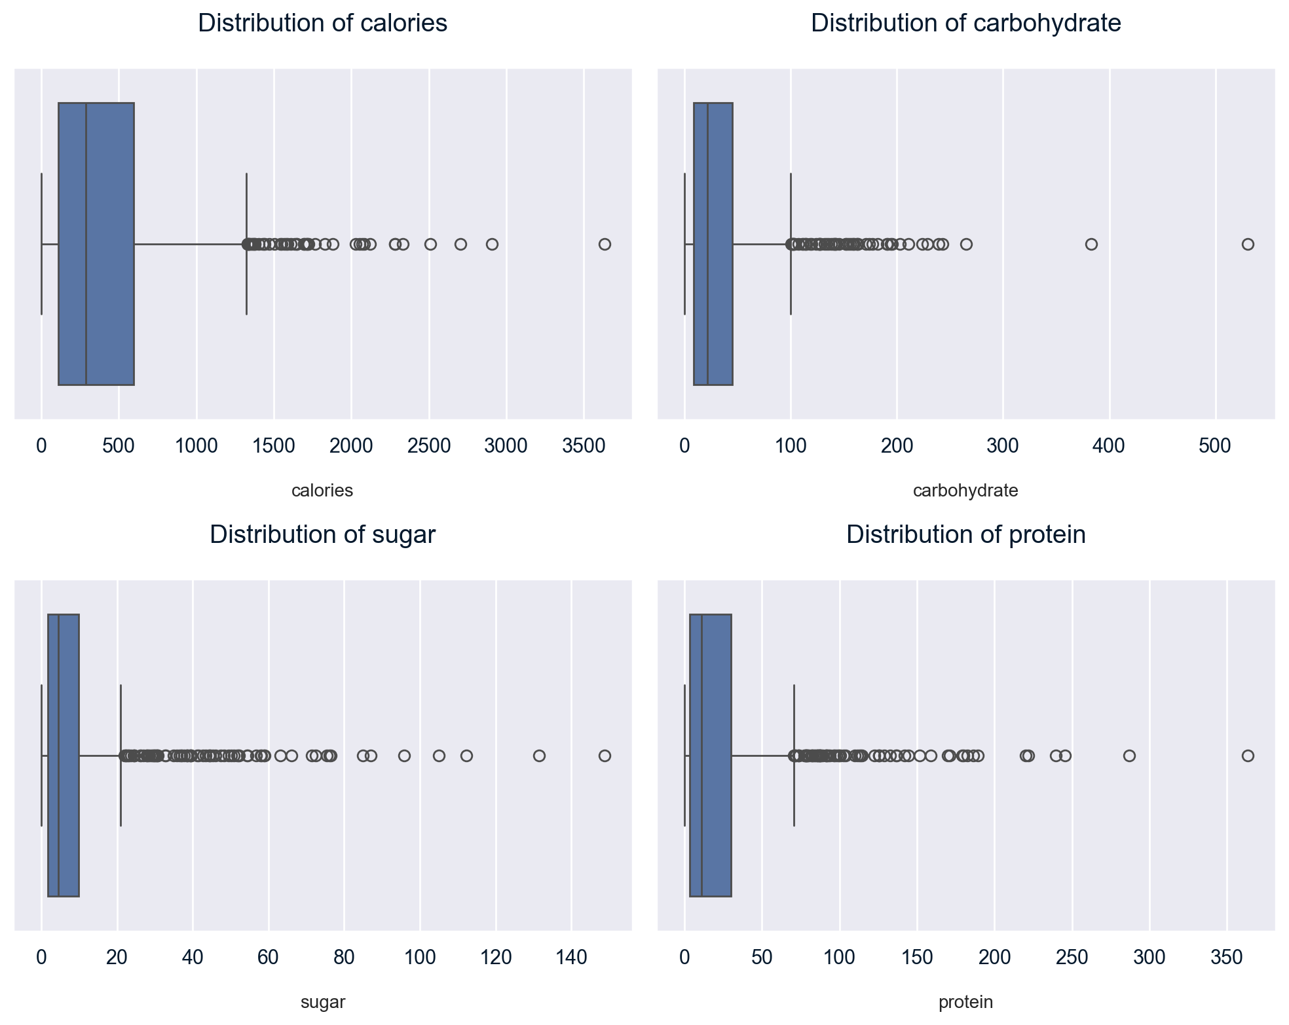
Distribution Graphs of Macronutrients

Slide 6
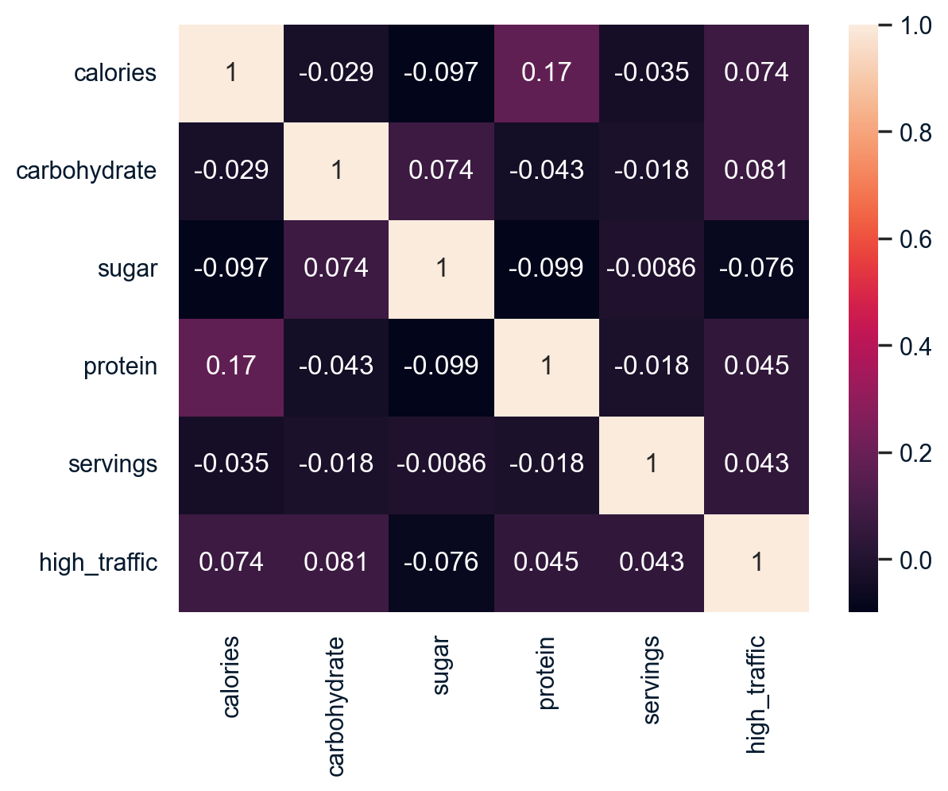
Correlation Graph of Numeric Variables

Slide 7
Choosing Binary Classification Model
Logistic Regression:
Used as the baseline model.
Ideal for binary classification due to its simplicity and interpretability.
Provides a clear understanding of the relationship between features and the probability of the positive class.
Linear Support Vector Machine (SVM):
Used for comparison with the baseline model.
Effective in high-dimensional spaces and linear decision boundaries.
Finds the optimal hyperplane that separates classes with the maximum margin.

Slide 8
Model Performance Evaluation Metrics
Overall Accuracy
Measures general classification effectiveness across all classes.
Better when the goal is to understand the model’s overall performance.
Good when close to 100%; indicates high correct classification rate.
F1-Score
Balances precision and recall, reflecting model performance on false positives and false negatives.
Better when there is a need to balance false positives and false negatives.
Good when close to 1; indicates a strong balance between precision and recall.
ROC-AUC Score
Assesses the model's ability to distinguish between high and low traffic recipes.
Better when evaluating the model’s ability to differentiate between classes.
Good when close to 1; indicates excellent ability to distinguish between classes.
Precision for Class 1 (KPI)
Evaluates the accuracy in identifying high traffic recipes among those classified as high traffic.
Better when the focus is on correctly identifying high traffic recipes to boost traffic & subscriptions.
Good when close to 1; indicates high accuracy in identifying true high traffic recipes.

Slide 9


Model Performance Results
Base Models:
Fine Tuned Models:

Slide 10
Recommendation
Prioritize Recipe Categories: Promote recipes from 'Potato', 'Vegetable', 'Chicken', and 'Pork' to boost website traffic.
Consider Macronutrient Content: Explore specific macronutrient profiles in high-traffic categories for potential benefits.
Implement Predictive Model: Use the tuned Logistic Regression model for better precision for predicting high traffic recipes (81.52%) and overall accuracy, with stable F1-score and ROC-AUC.
Monitor and Refine: Continuously track model performance and refine with new data and additional features.
Homepage Optimization: Utilize the model's predictions to prioritize high-traffic recipes on the homepage, which results to increasing website traffic and subscriptions.

Slide 11


Thank you
Recipe Site Traffic Analysis & Prediction
By
Zehan Alam

